Slide 1


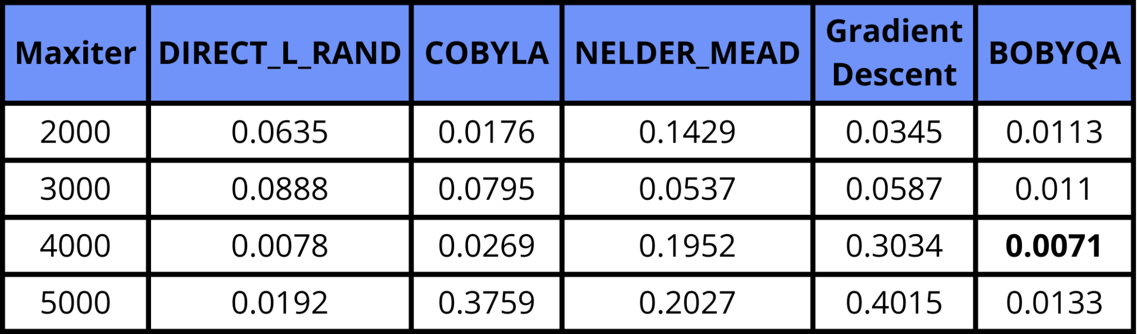
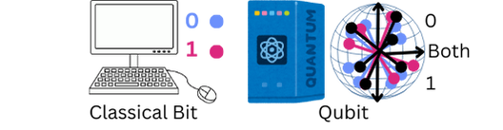

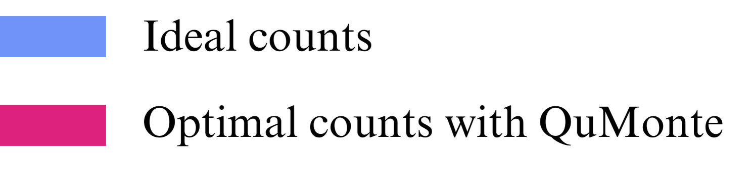
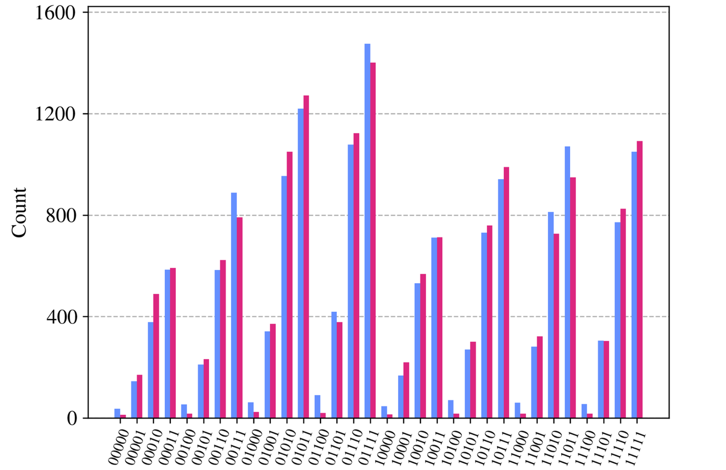
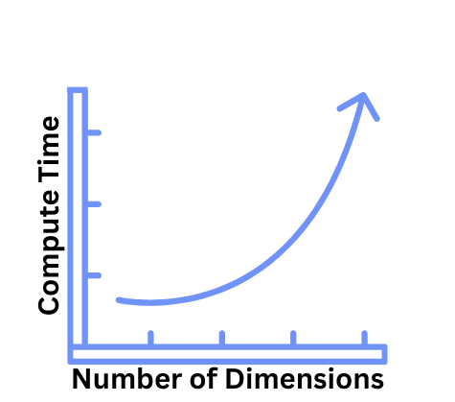
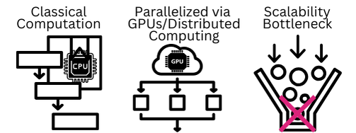
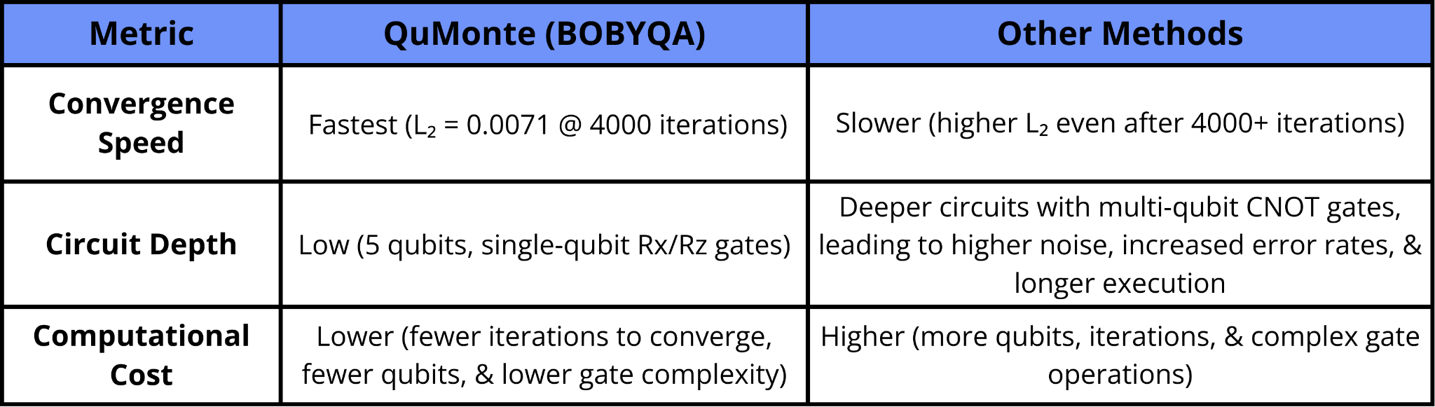
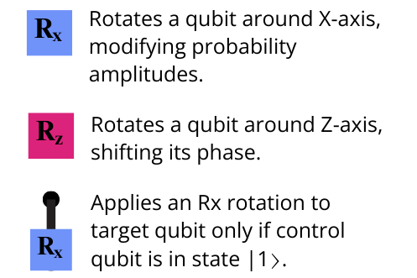
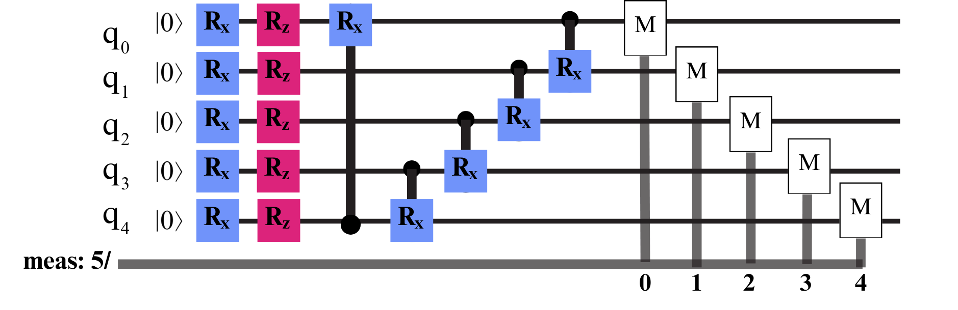

Quantum Computing for Financial Risk Analysis:
Pricing Fixed-Income Assets with QuMonte
Sophia Rebello, Dr. Tirthak Patel (Advisor)
Department of Computer Science, Rice University
Scan Me!
Introduction
Results
Why Quantum Computing? → Uses quantum mechanics for exponential speedup in solving complex problems beyond classical.
Qubits are quantum units of
information in|0⟩,|1⟩, or a
superposition—weighted
probability of |0⟩ & |1⟩.
Quantum gates manipulate qubits, altering their state probabilities.
Quantum circuits are sequences of gates on
qubits, leveraging parallel computation &
amplitude amplification for enhanced
computing, with applications in healthcare,
cybersecurity, finance, energy, logistics, etc.
BOBYQA
consistently
outperforms
other
optimizers,
achieving the
lowest L₂ norm
(0.0071 at
maxiter=4000),
demonstrating superior precision.
ss
Histogram comparing QuMonte’s optimized circuit (BOBYQA) to ideal counts.
Optimized circuit closely matches ideal distributions, demonstrating QuMonte’s effectiveness & precision in fine-tuning circuit parameters.
Optimization scores from various optimizers minimizing the L₂ norm, where lower values indicate higher accuracy & simulation precision.
Motivation
Monte Carlo simulations use random sampling to model risk & generate probabilistic scenarios for financial decision making, including fixed-income asset pricing.
Issue → Becomes slow & expensive in high dimensions.
Traditional Monte Carlo methods (linear, sequential,
or GPU-parallelized)
struggle to scale, with
performance deteriorating in
complex financial markets.
Our Solution: QuMonte is a quantum software solution that improves Monte Carlo efficiency, scalability, & precision through optimized code & architectural enhancements.
Our Approach: We utilize Qiskit to optimize quantum code for IBM’s architecture, reducing noise & gate depth. Variational Quantum Algorithms (VQAs) are then used to minimize the L₂ norm, (Euclidean distance) between circuit output & a target financial distribution.
Quantum States (5 Qubit System)
Analysis
Why is QuMonte superior to existing Monte Carlo methods?
Comparison of QuMonte’s advantage over traditional methods.
Optimized quantum circuit reduces gate depth & improves accuracy by 7% compared to baseline configurations.
With an optimization score near 0.01, QuMonte enhances financial model precision & efficiency while reducing computational cost.
Design & Implementation
We use the circuit below, which uses only Rx and Rz rotation gates, to minimize gate depth and reduce noise.
Circuit Design: A 5-qubit quantum circuit with Rx and Rz gates is transpiled to a native gate set to reduce complexity.
Optimization: VQAs iteratively tune 𝜃₁to 𝜃₁₀ using the BOBYQA optimizer to minimize the L₂ norm.
Simulation & Testing: Evaluated performance through simulations and IBM hardware tests.
Metrics: Accuracy assessed via L₂ norm, with Qiskit generating outcome histograms for conditional probabilities across all 32 states.
QuMonte’s parameterized quantum circuit & gate structure
Conclusion
Circuits optimized with QuMonte’s BOBYQA engine reduce quantum noise, depth, & computational complexity for higher accuracy.
QuMonte provides a blueprint for applying architectural principles to develop scalable quantum software in financial risk assessment.
Future work will refine the quantum ansatz, optimize hyperparameters and circuit measurements to enhance computation speed, and extend applications to basket and European Call/Put options.
References
[1] Andrew Thomas Arrasmith, Ryan Babbush, Simon C Benjamin, Suguru Endo, Keisuke Fujii, Jarrod R McClean, Kosuke Mitarai, Xiao Yuan, Lukasz Cincio, Patrick Joseph Coles, et al. 2021. Variational quantum algorithms. Nature Reviews Physics 3, 9 (2021), 625–644.
[2] Qiskit Community. 2023. Qiskit Finance: Open Source Quantum Computing Finance Tools. https://github.com/qiskit-community/qiskitfinance. Accessed: 2024-08-22.
[3] Ante Fahlkvist and Alfred Kheiltash. 2023. The Impact of Quantum Computing on the Financial Sector: Exploring the Current Performance and Prospects of Quantum Computing for Financial Applications through Mean-Variance Optimization.
[4] Dmitry Grinko, Julien Gacon, Christa Zoufal, and Stefan Woerner. 2021. Iterative quantum amplitude estimation. npj Quantum Information 7, 1 (2021), 52.
[5] Sukin Sim, Peter D Johnson, and Alán Aspuru-Guzik. 2019. Expressibility and entangling capability of parameterized quantum circuits for hybrid quantum-classical algorithms. Advanced Quantum Technologies 2, 12 (2019), 1900070.
[6] Daiwei Zhu, Weiwei Shen, Annarita Giani, Saikat Ray-Majumder, Bogdan Neculaes, and Sonika Johri. 2023. Copula-based risk aggregation with trapped ion quantum computers. Scientific Reports 13, 1 (2023), 18511.
Acknowledgement: This research was supported by Rice University (RU), RU George R. Brown School of Engineering & Computing, RU Department of Computer Science, Ken Kennedy Institute, and Rice Quantum Initiative, which is a part of the Smalley-Curl Institute.

